Slide 1
JAXB Annotations

Slide 2
Module Overview
In this Module, we will learn the following:
What is JAXB
Using JAXB Annotations to Marshal Java Objects to XML
Using JAXB Annotations to Unmarshall XML into Java Objects
Handling Faults
Using SoapUl

Slide 3
Using JAXB Annotations Part 1
JAXB stands for Java Architecture for XML Binding.
It is a Java standard that defines how Java objects are converted from and to XML. It uses a standard set of mappings.
An API is defined for reading and writing Java objects to and from XML documents.
As JAXB is defined via a specification, it is possible to use different implementations for this standard.
A service provider is defined which allows the selection of the JAXB implementation and entire process becomes relatively easy.
The central elements are indicated using Annotations.

Slide 4
Using JAXB Annotations Part 1
List of JAXB Annotations
ANNOTATION | SCOPE | DESCRIPTION
@XmlRootElement | Class, Enum | Defines the XML root element. Root Java classes need to be registered with the JAXB context when it is created.
@XmlAccessorType | Package, Class | Defines the fields and properties of your Java classes that the JAXB engine uses for binding. It has four values: PUBLIC_MEMBER, FIELD, PROPERTY and NONE.
@XmlAccessorOrder | Package, Class | Defines the sequential order of the children.
@XmlType | Class, Enum | Maps a Java class to a schema type. It defines the type name and order of its children.
@XmlElement | Field | Maps a field or property to an XML element
@XmlAttribute | Field | Maps a field or property to an XML attribute
@XmlTransient | Field | Prevents mapping a field or property to the XML Schema
@XmlValue | Field | Maps a field or property to the text value on an XML tag.
@XmlList | Field, Parameter | Maps a collection to a list of values separated by space.
@XmlElementWrapper | Field | Maps a Java collection to an XML wrapped collection

Slide 5
Demo: Using JAXB Annotations Part 1
Duration: 20 min Using JAXB to Marshal Java Objects to XML
In this demo we need to model a product for an e-commerce store. Apart from fields, such as product Id, description, image URL, and price, a Product object is also composed of a Customer object that represents the user who adds the product to the store.
We will be using some JAXB Annotations as below:
Annotation | Description
@XmlRootElement | It indicates the root level XML element. In case name attribute(optional attribute) is not specified then by default class name is used as root element.
XmlAttribute | It indicates the attribute of the root element
XmlElement | used on the properties of the class that will be the sub-elements of the root element.

Slide 6
Demo: Using JAXB Annotations Part 1 Cont..
public Customer setName(String name) {
this.name = name;
return this;
}
public String getEmail() {
return email;
}
public Customer setEmail(String email) {
this.email = email;
return this;
}
@Override
public String toString() {
final StringBuffer sb = new StringBuffer("Customer{");
sb.append("id=").append(id);
sb.append(", name='").append(name).append('\'');
sb.append(", email='").append(email).append('\'');
sb.append('}');
return sb.toString();
}
}
We will marshal the Product object and Customer object into XML by using JAXB.
Below is the Customer POJO to model the customer.
Create a Java Project under a package com.test.jaxb.domain
package com.test.jaxb.domain;
public class Customer {
private Long id;
private String name;
private String email;
public Customer() {
}
public Customer(Long id, String name, String email) {
this.id = id;
this.name = name;
this.email = email;
}
public Long getId() {
return id;
}
public Customer setId(Long id) {
this.id = id;
return this;
}
public String getName() {
return name;
}
Notes:
Note: No dependency additions required as JAXB is bundled with the JDK as of JDK 1.6

Slide 7
Demo: Using JAXB Annotations Part 1 Cont..
Product POJO as follows:
Product.java
Package com.test.jaxb.domain;
import javax.xml.bind.annotation.*;
import java.math.BigDecimal;
@XmlRootElement(name = "product")
//@XmlAccessorType(XmlAccessType.FIELD)
public class Product {
@XmlAttribute(name = "id")
private String productId;
@XmlElement(name = "description")
private String description;
@XmlElement(name = "price")
private BigDecimal price;
public Product(){ }
public Product(String productId, String description,
BigDecimal price,) {
this.productId = productId;
this.description = description;
this.price = price;
}
Notes:
Note: JAXB does XML TO Java object conversion too.
Which is why it needs a no-args constructor- it’ll need to instantiate the object first.

Slide 8
Demo: Using JAXB Annotations Part 1 Cont..
@Override
public String toString() {
return "Product{" +
"\n productId='" + productId + '\'' +
",\n description='" + description + '\'' +
",\n price=" + price +
'}';
}
}
The Product POJO class can be ready to marshalled into XML. For this , let us write a JUnit test class.

Slide 9
Demo: Using JAXB Annotations Part 1 Cont..
The test class is:
ProductToXmlTest.java:
package com.test.jaxb.testmarshal;
import com.test.jaxb.domain.Product;
import com.test.jaxb.domain.Customer;
import org.junit.After;
import org.junit.Before;
import org.junit.Test;
import javax.xml.bind.JAXBContext;
import javax.xml.bind.JAXBException;
import javax.xml.bind.Marshaller;
import java.io.File;
import java.io.FileNotFoundException;
import java.math.BigDecimal;
public class ProductToXmlTest {
private Product product;
@Before
public void setUp() {
long l = 10;
Long longId = new Long(l);
Customer customer = new Customer(longId, “anshu", "
anshu@testmail.in");
product = new Product("PO1", "Sky Blue Shirt", " http://babich.biz/content/images/2016/08/1-OIZULK_-jZFmQ3oQ1WsmHg.jpeg ", new BigDecimal(18.95), customer);
}
We Need to add junit.jar and hamcrest-core.jar file to project classpath libraries
@After
public void tearDown() {
product = null;
}
@Test
public void testObjectToXml() throws JAXBException, FileNotFoundException {
JAXBContext jaxbContext = JAXBContext.newInstance(Product.class);
Marshaller marshaller = jaxbContext.createMarshaller();
marshaller.setProperty(Marshaller.JAXB_FORMATTED_OUTPUT, true);
marshaller.marshal(product, new File("product.xml"));
marshaller.marshal(product, System.out);
}
}
Notes:
In setup() method Instantiation and initialization of a Customer and a Product object marked as @Before.
The JAXBContext.newInstance() method obtains a JAXBContext for the Product class that you want to marshal. JAXBContext provides the entry point for the JAXB API.
Marsherller object creates a Marshaller through a call to the createMarshaller() method of JAXBContext. In JAXB, the Marshaller class governs the process of marshalling Java objects into XML data through its various marshalling methods.
After that we configured the Marshaller. The true value of the JAXB_FORMATTED_OUTPUT property instructs the Marshaller to generate the XML with proper indentation.
Then we Call the marshal() method on the Marshaller with the initialized Product object and the file to write the XML.
And at last Marshals the object to the “standard” output stream.

Slide 10
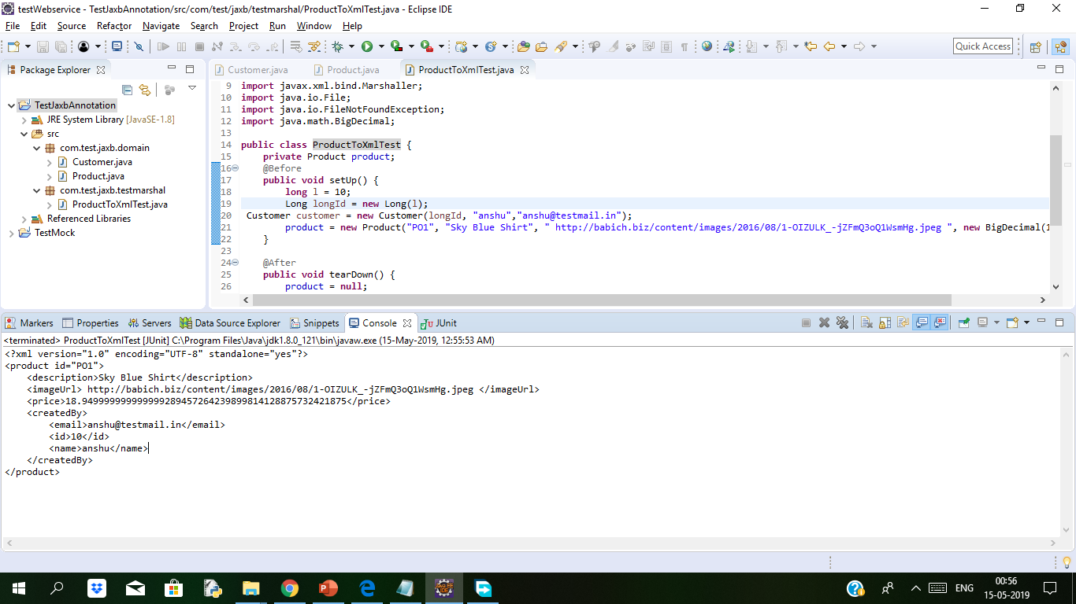
Demo: Using JAXB Annotations Part 1 Cont..
Notes:
product/.xml file after running the program as junit test.
<?xml version="1.0" encoding="UTF-8" standalone="yes"?>
<product id="PO1">
<description>Sky Blue Shirt</description>
<imageUrl> http://babich.biz/content/images/2016/08/1-OIZULK_-jZFmQ3oQ1WsmHg.jpeg </imageUrl>
<price>18.949999999999999289457264239899814128875732421875</price>
<createdBy>
<email>anshu@testmail.in</email>
<id>10</id>
<name>anshu</name>
</createdBy>
</product>

Slide 11
Demo: Using JAXB Annotations Part 1 Cont..
Below is the xml code generated when we run the application as Junit Test
<?xml version="1.0" encoding="UTF-8" standalone="yes"?>
<product id="PO1">
<description>Sky Blue Shirt</description>
<imageUrl> http://babich.biz/content/images/2016/08/1-OIZULK_-jZFmQ3oQ1WsmHg.jpeg </imageUrl>
<price>18.949999999999999289457264239899814128875732421875</price>
<createdBy>
<email>anshu@testmail.in</email>
<id>10</id>
<name>anshu</name>
</createdBy>
</product>

Slide 12
Demo: Using JAXB Annotations Part 2
Using JAXB to Unmarshall XML into Java Objects
Unmarshalling XML with JAXB to a Java object involves creating an Unmarshaller on the JAXBContext and calling the unmarshal() method. This method accepts the XML file to unmarshal.
Duration: 10 min
The JUnit test class to unmarshal the generated product.xml back to the Product and User objects is this:
XmlToProductTest.java:
package com.test.jaxb.testunmarshal;
import org.junit.After;
import org.junit.Before;
import org.junit.Test;
import com.test.jaxb.domain.Product;
import javax.xml.bind.JAXBContext;
import javax.xml.bind.JAXBException;
import javax.xml.bind.Marshaller;
import javax.xml.bind.Unmarshaller;
import java.io.File;
import java.io.FileNotFoundException;
import java.math.BigDecimal;
public class XmlToProductTest {
private Product product;

Slide 13
Demo: Using JAXB Annotations Part 2 Cont..
@Test
public void testXmlToObject() throws JAXBException, FileNotFoundException {
File file = new File("product.xml");
JAXBContext jaxbContext = JAXBContext.newInstance(Product.class);
Unmarshaller unmarshaller = jaxbContext.createUnmarshaller();
product = (Product) unmarshaller.unmarshal(file);
System.out.println(product);
}
}
In above XmlToProductTest class, a JAXBContext initialized with Product is used. The createUnmarsheller()method returns an Unmarshaller.
A JAXB Unmarshaller governs the process of unmarhshalling XML data into a Java object tree.
Finally, the unmarshal() method unmarshals the File object for product.xml into the Product POJO.

Slide 14
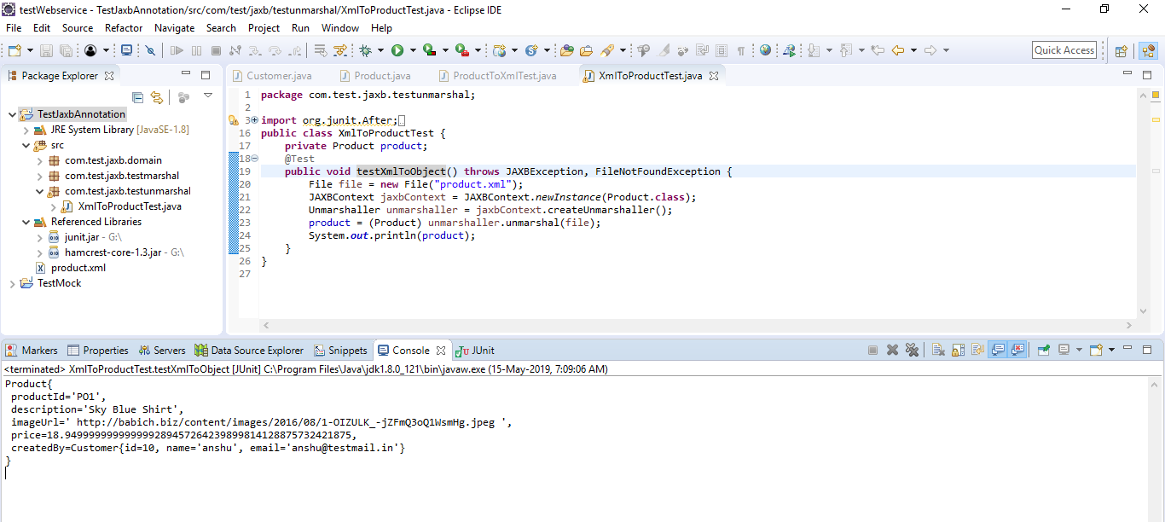
Demo: Using JAXB Annotations Part 2 Cont..
Notes:
The code generated after product.xml when we run the application as junit test
Product{
productId='PO1',
description='Sky Blue Shirt',
imageUrl=' http://babich.biz/content/images/2016/08/1-OIZULK_-jZFmQ3oQ1WsmHg.jpeg ',
price=18.949999999999999289457264239899814128875732421875,
createdBy=Customer{id=10, name='anshu', email='anshu@testmail.in'}
}

Slide 15
Demo: Using JAXB Annotations Part 2 Cont..
Product{
productId='PO1',
description='Sky Blue Shirt',
imageUrl=' http://babich.biz/content/images/2016/08/1-OIZULK_-jZFmQ3oQ1WsmHg.jpeg ',
price=18.949999999999999289457264239899814128875732421875,
createdBy=Customer{id=10, name='anshu', email='anshu@testmail.in'}
}

Slide 16
Handling Faults
In case any an error is encountered while processing a web service , the behaviour of the error needs to be communicated to the client, or sender of the request of various disparate platforms.
You can understand how to describe the error in SOAP message using a SOAP fault by referring the specification at http://www.w3.org/TR/soap. In general, a SOAP fault is analogous to an application exception. SOAP faults are generated by receivers to report business logic errors or unexpected conditions.
In JAX-WS, Java exceptions (java.lang.Exception) that are thrown by your Java Web service are mapped to a SOAP fault. These are returned to the client to communicate the reason for failure.

Slide 17
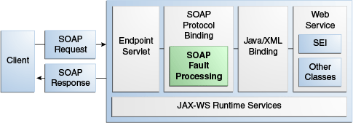
Handling Faults Cont..
SOAP faults types:
SOAP Fault Name | Description
Modeled | These are predefined SOAP faults. This type of faults are thrown from the business logic and maps to wsdl:fault definitions in the WSDL file.
Unmodeled | This type of fault is from runtime exception and there is no business logic fault in WSDL. These Java exceptions are represented as generic SOAP fault exceptions javax.xml.ws.soap.SOAPFaultException
How SOAP Faults Are Processed

Slide 18
Handling Faults Cont..
Example of SOAP Fault Message
<?xml version="1.0"?>
<soap:Envelope
xmlns:soap='http://schemas.xmlsoap.org/soap/envelope'>
<soap:Body>
<soap:Fault>
<faultcode>soap:VersionMismatch</faultcode>
<faultstring, xml:lang=‘”en">
Message was not SOAP 1.1 compliant
</faultstring>
<faultactor>
http://sample.org.ocm/jws/authnticator
</faultactor>
</soap:Fault>
</soap:Body>
</soap:Envelope>

Slide 19
Demo: Handling Faults Cont..
Duration: 15 min
Creating and Implementing a Custom Exception
Here we will use modelled faults. First we will create a custom Java exception and throw it from within the Web service.
In below Example, Web service throws Custom Exception called RequiredName and is thrown when the input argument is empty.
Web Service With Custom Exception
package demo;
import javax.jws.WebService;
@WebService(name=“HandlingFaultsDemo", serviceName=" HandlingFaultsDemoService")
public class HandlingFaultsDemo {
public String sayMessage(String message) throws RequiredName {
System.out.println(“Welcome to HandlingFaults Demo: " + message);
if (message == null || message.isEmpty()) {
throw new RequiredName();
}
return “Welcome: '" + message + "'";
}
}

Slide 20
Demo: Handling Faults Cont..
Below is the code which shows the class for the exception, RequiredName.java.
Custom Exception Class (RequiredName)
package examples;
import java.lang.Exception;
public class RequiredName extends Exception {
public RequiredName() {
super(“Please enter your name.");
}
}

Slide 21
Demo: Handling Faults Cont..
Example of WSDL with Modeled Exceptions
<?xml version="1.0" encoding="UTF-8" ?>
<definitions
xmlns:soap="http://schemas.xmlsoap.org/wsdl/soap/"
xmlns:tns="http://examples/"
xmlns:xsd="http://www.w3.org/2001/XMLSchema"
xmlns="http://schemas.xmlsoap.org/wsdl/"
targetNamespace="http://examples/"
name="HandlingFaultsDemoService">
<types>
<xsd:schema>
<xsd:import namespace="http://examples/"
schemaLocation="http://localhost:7001/HandlingFaultsDemo/HandlingFaultsDemoService?xsd=1"/>
</xsd:schema>
</types>
<message name="sayHandlingFaultsDemo">
<part name="parameters" element="tns:sayHandlingFaultsDemo" />
</message>
<message name="sayHandlingFaultsDemoResponse">
<part name="parameters" element="tns:sayHandlingFaultsDemoResponse" />
</message>
<message name="RequiredName">
<part name="fault" element="tns:RequiredName" />
</message>
<portType name="HandlingFaultsDemo">
<operation name="RequiredName">
<input message="tns:RequiredName" />
<output message="tns:RequiredNameResponse" />
<fault message="tns:RequiredName" name="RequiredName" />
</operation>
</portType>
<binding name="HandlingFaultsDemoPortBinding" type="tns:HandlingFaultsDemo">
<soap:binding transport="http://schemas.xmlsoap.org/soap/http"
style="document" />
<operation name="RequiredName">
<soap:operation soapAction="" />
<input>
<soap:body use="literal" />
</input>
<output>
<soap:body use="literal" />
</output>
<fault name="RequiredName">
<soap:fault name="RequiredName" use="literal" />
</fault>
</operation>
</binding>
<service name="HandlingFaultsDemoService">
<port name="HandlingFaultsDemoPort" binding="tns:HandlingFaultsDemoPortBinding">
<soap:address
location="http://localhost:7001/HandlingFaultsDemo/HandlingFaultsDemoService" />
</port>
</service>

Slide 22
Demo: Handling Faults Cont..
How the Fault is Communicated in the SOAP Message
Example shows how the SOAP fault is communicated in the resulting SOAP message when the RequiredName Java exception is thrown.
Example SOAP Fault Message for RequiredName Exception
<?xml version = '1.0' encoding = 'UTF-8'?>
<S:Envelope xmlns:S="http://schemas.xmlsoap.org/soap/envelope/">
<S:Body>
<S:Fault xmlns:ns4="http://www.w3.org/2003/05/soap-envelope">
<faultcode>S:Server</faultcode>
<faultstring>Your name is required.</faultstring>
<detail>
<ns2:RequiredName xmlns:ns2="http://examples/">
<message>Your name is required.</message>
</ns2:RequiredName>
<ns2:exception xmlns:ns2="http://jax-ws.dev.java.net/"
class="examples.RequiredName" note="To disable this feature, set
com.sun.xml.ws.fault.SOAPFaultBuilder.disableCaptureStackTrace system
property to false">
<message>Your name is required.</message>
<ns2:stackTrace>
<ns2:frame class="examples.HandlingFaultsDemo" file="HandlingFaultsDemo.java"
line="14" method="RequiredName"/>
. </ns2:stackTrace>
</ns2:exception>
</detail>
</S:Fault>
</S:Body>
</S:Envelope>

Slide 23
Using SOAPUI
SoapUI Pro enables reuse and eliminates the rework you have to do in SoapUI Open Source. It lets you test APIs many times faster and envision even more advanced test scenarios, so you can get more done in less time.
Features of SOAPUI
Easy Automation For Your API Tests
Simple, Point & Click Testing
Property Transfer
Assertions
Data-driven Testing Made Easy with SoapUI Pro
Data source
TestSteps
DataSource Loop
Security Scan Wizard
Types of Security Tests in SoapUI Pro:
Boundary Scan
Cross-Site Scripting
Fuzzing Scan
Invalid Types
Malformed XML
Malicious Attachment
SQL Injection
XML Bomb
XML Injection
Custom Scans
Security Test Generator

Slide 24
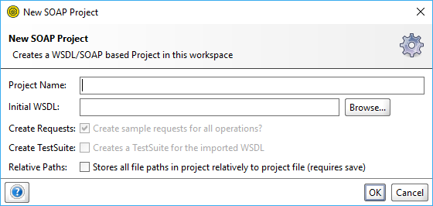
Demo: Using SOAPUI
Duration: 30 min
You can download SOAPUI from https://www.soapui.org/downloads/latest-release.html
After downloading do proper installation.
Steps to create SOAP project in SOAPUI
Create New Project
To create a new SOAP project, select File > New SOAP Project.
Specify the name for your new project and the WSDL file that SoapUI will use for the initial configuration, then select the necessary options.
Notes:
Reference: https://www.soapui.org/soapui-projects/soapui-projects.html
Is this demo complete?

Slide 25
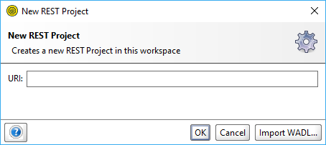
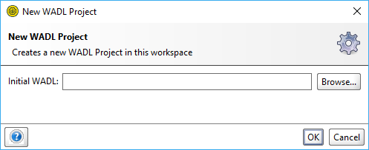
Demo: Using SOAPUI Cont..
Click OK. SoapUI will generate the service and, optionally, test suite and mock service.
To create a new REST project, select File > New REST project.
Specify an URI to use for the project generation in the subsequent dialog and click OK.
You can also click Import WADL to switch to the New WADL project dialog.

Slide 26
Demo: Using SOAPUI Cont..
To create a new empty project, select File > Create Empty Project. It will immediately appear in the Navigator, and the editor for the project will become available in the Workspace.

Slide 27
Summary
In this Module, we have learnt the following:
What is JAXB
Various JAXB Annotations
Using JAXB Annotations to Marshal Java Objects to XML
Using JAXB Annotations to Unmarshall XML into Java Objects
How to handle Faults
Using SoapUl

Slide 28

Thank You

